Slide 1




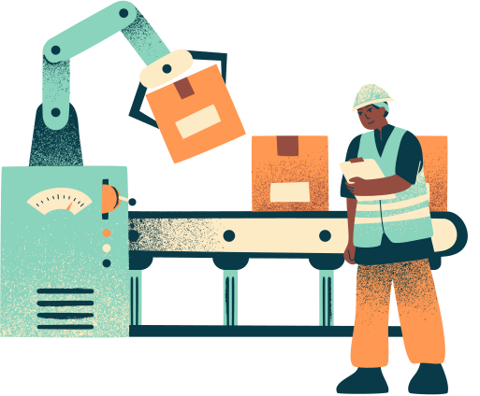
manufacturing down time
Presentation

Slide 2
Abdelrahman Ibrahim
Jasmine Tawfiq
Sara Akram
Malak Zein
Mariam Sayed
Mariam Yahia
Our Team

Slide 3
Introduction
The Problem
Unplanned machine breakdowns cost time and money, causing a 15% drop in weekly production capacity. Without data, maintenance teams are stuck constantly reacting to failures after they happen.

Slide 4
Introduction
Our Solution
We developed a smart data pipeline that uncovers hidden patterns—like why night shifts face 22% more delays. By using machine learning, our system predicts next-day breakdowns with 84.2% accuracy, allowing teams to fix machines before they break.

Slide 5
The Challenge: Why This Matters
1Eroding Efficiency
Manufacturing downtime is a primary driver of operational cost escalation and production efficiency loss.
2
Schedule Disruption
Operating without predictive insights leads to a reactive "firefighting" culture rather than proactive maintenance.
3
The Visibility Gap
A lack of visibility into downtime patterns leaves significant efficiency gains untapped across the industry.

Slide 6
Strategic Objectives
02
Pattern Detection
01
Data Preparation
Analyze downtime across machines and shifts to reveal operational patterns.
Clean and preprocess manufacturing data to ensure accuracy for downstream analysis.
04
Predictive Capability
03
Root Cause Analysis
Build models to forecast downtime with measurable accuracy and confidence.
Identify key factors—operator training, machine age—that affect efficiency.

Slide 7
05
Actionable Insights
Create dashboards to enable data-driven production and maintenance decisions.

Slide 8
Methodology & Technology Stack
01. Data Preprocessing
Clean and preprocess manufacturing data to ensure accuracy for downstream analysis.
.
02
PATTERN DETECTION
Analyze downtime across machines and shifts to reveal operational patterns.
03
.
ROOT CAUSE ANALYSIS
Identify key factors—operator training, machine age—that affect efficiency.

Slide 9
04
.
PREDICTIVE CAPABILITY
Build models to forecast downtime with measurable accuracy and confidence.
.
ACTIONABLE INSIGHTS
05
Create dashboards to enable data-driven production and maintenance decisions.

Slide 10

METHODOLOGY & TECHNOLOGY STACK
PROGRAMMING & DATA
Python / SQL / Pandas

Slide 11

METHODOLOGY & TECHNOLOGY STACK
MACHINE LEARNING
Scikit-learn

Slide 12
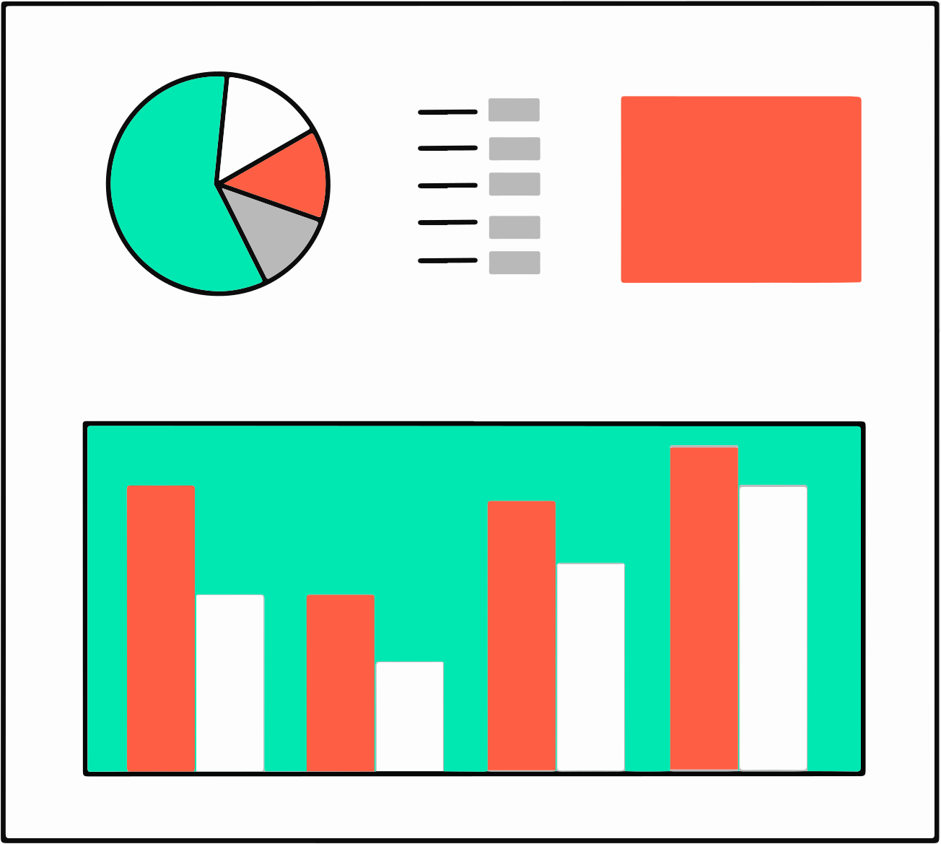
METHODOLOGY & TECHNOLOGY STACK
VISUALIZATION
Tableau / Matplotlib

Slide 13

METHODOLOGY & TECHNOLOGY STACK
ENVIRONMENT
Jupyter Notebook

Slide 14
THE DATA: WHAT WE ANALYZED
DATASET COMPONENTS Machine operation metrics Downtime events
Production batch data Operational KPIs
ANALYSIS SCOPE
Multiple machines across lines
Three-shift schedule Extended historical period
Root cause variables (operator, age, product)

Slide 15
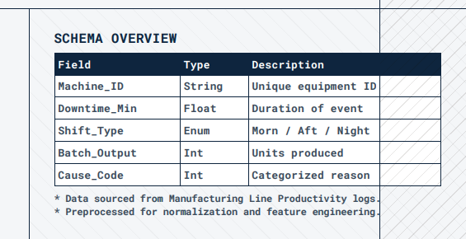

Slide 16
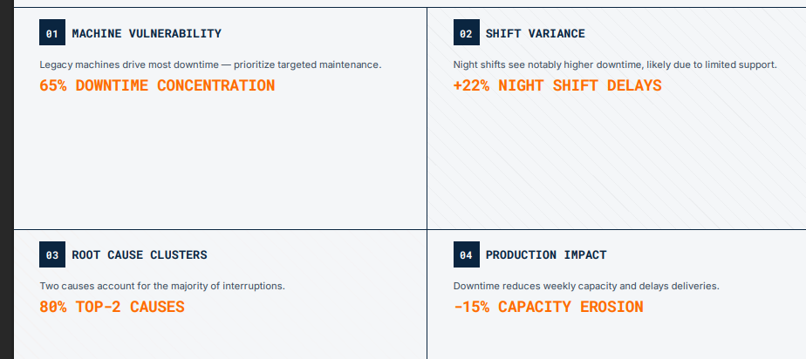
KEY FINDINGS: DOWNTIME PATTERNS

Slide 17
FORECASTING MODEL: PROACTIVE PREVENTION
NEXT-DAY PREDICTION
Machine learning models forecast expected downtime hours for the following operational day, allowing for preemptive maintenance scheduling

Slide 18
FORECASTING MODEL: PROACTIVE PREVENTION
BATCH CAPACITY ESTIMATION
By integrating predicted downtime, the system estimates production batch capacity with high precision, optimizing daily scheduling

Slide 19
FORECASTING MODEL: PROACTIVE PREVENTION
FEATURE IMPORTANCE ANALYSIS
The model identifies which operational factors —such as machine age or operator shift—most strongly influence downtime likelihood
BUSINESS APPLICATION Maintenance teams transition from reactive "firefighting" to data-driven preventive interventions based on forecasted risk levels.

Slide 20
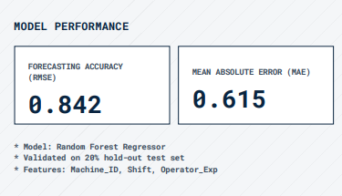
FORECASTING MODEL: PROACTIVE PREVENTION

Slide 21
INTERACTIVE DASHBOARD: OPERATIONAL INTELLIGENCE
DOWNTIME TRENDS
Visual representation of downtime patterns over time, enabling rapid trend identification and seasonal analysis
MACHINE EFFICIENCY
Side-by-side performance metrics across all production equipment to identify underperforming assets.
FORECASTING INSIGHTS
Integration of ML predictions directly into the UI to guide proactive maintenance and scheduling decisions.
DRILL-DOWN CAPABILITY
Interactive filters for shifts, operators, and machine types to isolate root causes of interruptions.

Slide 22
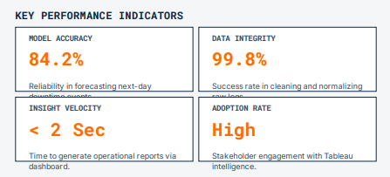
BUSINESS IMPACT: MEASURABLE OUTCOMES

Slide 23
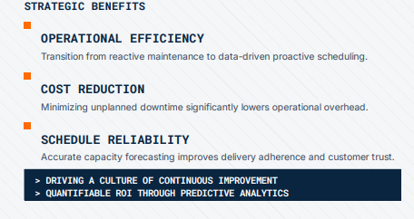
BUSINESS IMPACT: MEASURABLE OUTCOMES

Slide 24
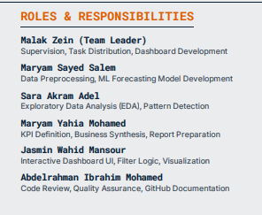
TEAM & EXECUTION ROADMAP

Slide 25
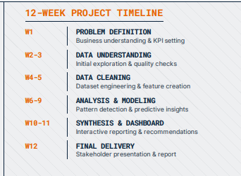
TEAM & EXECUTION ROADMAP

Slide 26
FUTURE ROADMAP: CONTINUOUS IMPROVEMENT
PHASE 2.0
PHASE 3.0
PHASE 4.0
ADVANCED FORECASTING
REAL-TIME MONITORING
PREDICTIVE MAINTENANCE
Moving beyond regression to deep learning architectures for complex temporal patterns
Transitioning from batch processing to live streaming data for immediate intervention.
Developing prescriptive models that suggest optimal maintenance actions autonomously

Slide 27
CONCLUSION: THE PATH FORWARD
01
DATA-DRIVEN CULTURE
Transitioning from intuition-based decisions to a rigorous , data-driven operational framework ensures long-term manufacturing excellence
02
PREDICTIVE POWER
Leveraging machine learning for downtime forecasting transforms maintenance from a reactive cost center to a proactive strategic asset
03
SCALABLE INSIGHTS
The developed architecture provides a scalable foundation for integrating realtime IoT data and advanced prescriptive analytics

Slide 28
Welcome to Q&A Time

Slide 29
Thank You

